Slide 1

Course: ARM Processor & Applications (15EECC207)
Faculty In Charge: Supriya Katwe
Bhagyashree K
Preeti Pillai

Slide 2
Course: ARM Processor & Applications
Course Outcomes (COs):
At the end of the course the student should be able to:
Discuss advanced microprocessor architecture and pipeline structure.
Write assembly language programs with a tradeoff between size and complexity and test it using development tools.
Develop an assembly level program for the given application using ARM or THUMB or both instruction set.
Discuss the concept of interrupt and their application.
Develop a C code for interfacing different ON/OFF board peripheral devices to LPC 2148 controller.

Slide 3
Unit-III EXTERNAL INTERRUPT
Lesson Schedule
Sl No. | Topic
1 | External interrupts
2 | Vector interrupt controller
3 | Interrupt -Registers
4 | Algorithm
5 | Program
6 | Simulation

Slide 4
Introduction
What is External Interrupt?
Interrupt caused by an external source such as external switch, sensor or monitoring device.
These interrupt are special events that require immediate attention.
The LPC2148 includes four External Interrupt Inputs as selectable pin functions.
The External Interrupt Inputs can optionally be used to wake up the processor from Power-down mode.
An active low/high level or falling/rising edge general purpose interrupt input.

Slide 5
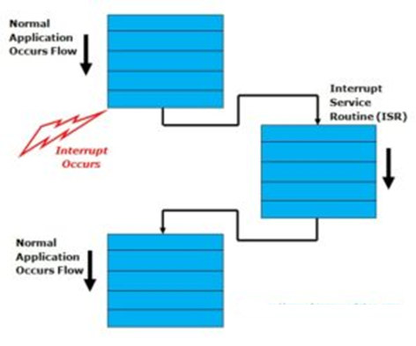
How Interrupt Works?

Slide 6
With no interrupt controller
Only few interrupts can be handled
Only for simple embedded system, cannot be used for complex systems.

Slide 7
Why interrupt controller?
You need to reduce average response time to one or more interrupts.
You have hard real-time requirements for interrupt performance.
You require non maskable interrupts.
You need to handle more interrupts .

Slide 8
Vectored Interrupt Controller(VIC)
LPC2148 uses ARM PrimeCell (PL190) Vectored Interrupt Controller for managing interrupts.
The VIC is used to handle all the on-chip interrupt sources from peripherals.
When interrupt occurs: VIC identifies the source of interrupts.
Passes requests on interrupt request pins as per the configuration.
If more than one interrupt occurs at a time, VIC resolves priority.

Slide 9
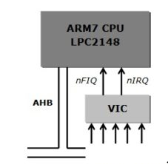
Each interrupt source is connected to the VIC on a fixed channel. Our application software can connect these channels to the CPU interrupt lines (FIQ, IRQ)
The AMBA (Advance High Performance Bus) is used for interface vectored interrupt controller to the ARM7 Core (LPC2148)

Slide 10
The vector Interrupt Controller (VIC) takes 32-interrupt request input and assigned them programmably into 3-categories, listed below:
FIQ | Fast Interrupt Request: For fast, low latency interrupt handling. FIQ have highest priority followed by interrupt vector 0-31. Only single FIQ source at a time is generally used in a system
Vectored IRQ | Vectored Interrupt Request: VIRQ have medium priority. Vectored Interrupt Controller has 32 vectored interrupt slots out of which 16 slots are used for vector addressing. Each slot contain vector address register & vector control register
Non-Vectored IRQ | Non-Vectored Request: Non Vectored IRQ has lowest priority. The VIC is capable of handling 16 peripherals as a vectored interrupt and at least one as an FIQ Interrupt. If in case there are more than 17 interrupt sources on chip, any extra interrupt can be serviced as a Non-Vectored Interrupt.

Slide 11
Seven Pins of PORT0 on LPC2148 Microcontroller can be configured as external interrupt input. The pin description is given as below:
Pin Name | Pin Direction | Pin Description
EINT0 | External Interrupt Input 0 | Pins P0.1 and P0.16 can be selected to perform EINT0 function
EINT1 | External Interrupt Input 1 | Pins P0.3 and P0.14 can be selected to perform EINT1 function
EINT2 | External Interrupt Input 2 | Pins P0.7 and P0.15 can be selected to perform EINT2 function
EINT3 | External Interrupt Input 3 | Pins P0.9, P0.20 and P0.30 can be selected to for EINT3

Slide 12
Regitsers
External Interrupt Mode register (EXTMODE)
External Interrupt Polarity register (EXTPOLAR)
External Interrupt Flag register (EXTINT)

Slide 13

External Interrupt Mode register (EXTMODE)
The bits in this register select whether each EINT pin is level- or edge-sensitive.
0-- Level-sensitivity is selected for EINT0/1/2/3
1-- EINT0/1/2/3 is edge sensitive.
Notes:
Level Triggering: In level triggering the circuit will become active when the gating or clock pulse is on a particular level.
Edge Triggering: In edge triggering the circuit becomes active at negative or positive edge of the clock signal.

Slide 14
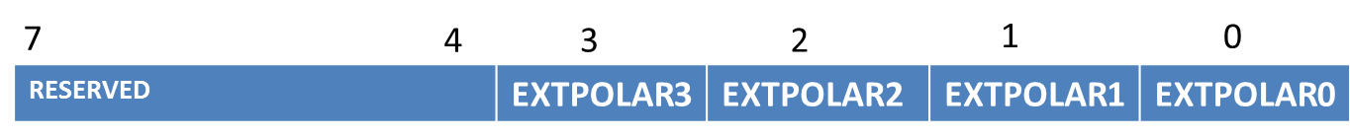
External Interrupt Polarity register (EXTPOLAR)
In level-sensitive mode, the bits in this register select whether the corresponding pin is high- or low-active.
In edge-sensitive mode, they select whether the pin is rising- or falling-edge sensitive.
0-- EINT0/1/2/3 is low-active or falling-edge sensitive
1-- EINT0/1/2/3 is high-active or rising-edge sensitive

Slide 15
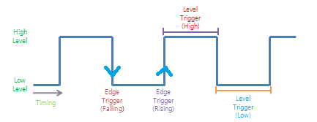
Level / Edge Sensitive Interrupt

Slide 16
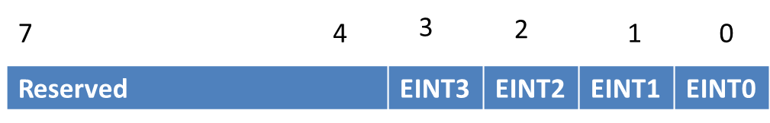
External Interrupt Flag Register (EXTINT)
The External Interrupt Flag Register contains interrupt flags for EINT0, EINT1, EINT2 and EINT3
Once a bit from EINT0 to EINT3 is set and an appropriate code starts to execute (handling wakeup and/or external interrupt), this bit in EXTINT register must be cleared. Otherwise the event that was just triggered by activity on the EINT pin will not be recognized in the
future.

Slide 17
Vectored Interrupt Controller(VIC)
The registers used for programming the interrupts are:
VICIntEnable
VICVectAddr
VICVectAddr0-VICVectAddr15
VICVectCntl0-VICVectCntl15

Slide 18
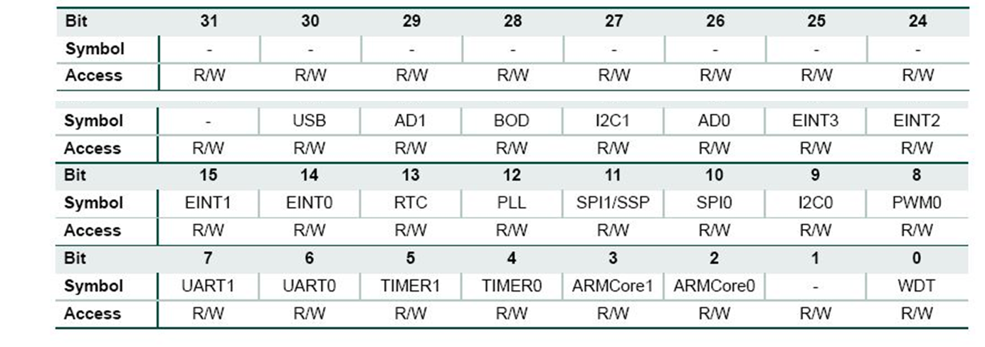
VICIntEnable
Interrupt Enable Register.
This register controls which of the 32 interrupt requests and software interrupts are enabled to contribute to FIQ or IRQ.
When a bit is set to 1, the corresponding interrupt is enabled.

Slide 19
VICVectAddr0-VICVectAddr15
Vector Address Registers 0-15 hold the addresses of the Interrupt Service routines (ISRs) for the 16 vectored IRQ slots.

Slide 20

VICVectCntl0-VICVectCntl15
Vector Control Registers 0-15 each control one of the 16 vectored IRQ slots. Slot 0 has the highest priority and slot 15 the lowest.
The first 5 bits in the Vector Control Registers (Bit 0 – Bit 4) contains the number of the interrupt request. The 5th bit (Bit 5) is used to enable the Vectored IRQ Slot.

Slide 21
For example, if we want to assign Slot 0 to EINT0, then the Vector Control Register must be declared as follows: VICVectCntl0 = 0x20 | 14;
Interrupt Source | Source Number in Decimal
WDT | 0
N/A | 1
ARMCore0 | 2
ARMCore1 | 3
TIMER0 | 4
TIMER1 | 5
UART0 | 6
UART1 | 7
PWM | 8
I2C0 | 9
SPI0 | 10
SPI1 | 11
Interrupt Source | Source number In Decimal
PLL | 12
RTC | 13
EINT0 | 14
EINT1 | 15
EINT2 | 16
EINT3 | 17
ADC0 | 18
I2C1 | 19
BOD | 20
ADC1 | 21
USB | 22

Slide 22
VICVectAddr
Vector Address Register
When an IRQ interrupt occurs, the IRQ service routine can read this register and jump to the value read.
Writing a value to this register indicates the VIC that the execution of the current interrupt is finished. Hence, this register is written with a dummy value at the end of the ISR to indicate the end of execution

Slide 23
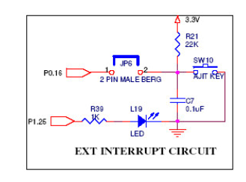
External Interrupt Circuit
When the SW10 is pressed the port line goes low and the external interrupt occurs at the port P0.16

Slide 24
Algorithm
Initialization Steps: External Interrupt in LPC2148 ARM7
Configure Pin Function
Select Edge/Level sensitive
Choose Signal Polarity
Enable the Vectored IRQ slot
Assign address of the ISR
Enable the external interrupt
Once Interrupt is detected
ISR Function is called automatically
Execute the ISR for desired application
Clear Interrupt Flag
Terminate ISR Execution
PINSEL1
EXTMODE
EXTPOLAR
VICVectCntl0
VICVectAddr0
VICIntEnable
Blink LEDs
EXTINT
VICVectAddr

Slide 25
Program
#include<LPC21XX.h>
#include<stdio.h>
void delay(unsigned int);
void extint0_ISR(void)__irq;
void delay(unsigned int );
int main(void)
{
PINSEL1=0x00000001;
EXTMODE=0x00000001;
VICVectAddr0=(unsigned long)extint0_ISR;
VICVectCntl0=0x20|14;
VICIntEnable|=0x00004000;
while(1)
}

Slide 26
void extint0_ISR(void)__irq
{
PINSEL0=0x00000000;
IODIR0=0x000f0000;
IOCLR0=0X000f0000; // ON LEDS
delay(100000);
IOSET0=0X000f0000; // OFF LEDS
delay(100000);
EXTINT|=0X00000001; //Clear interrupt flag
VICVectAddr=0; // End of interrupt execution
}
void delay(unsigned int x)
{
unsigned int i;
for(i=0;i<x;i++) ;
}

Slide 27
Summary
Interrupt is a external signal
Vic
Registers for configuration
Vic registers
Program

Slide 28
Thank You

